Slide 1
Orthogonality and Least Squares
5.1 Inner Product, Length, and Orthogonality
Bumhee Cho

Slide 2





Slide 3
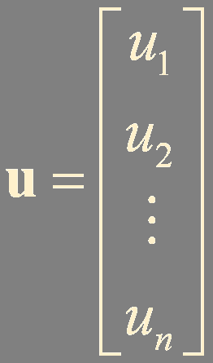
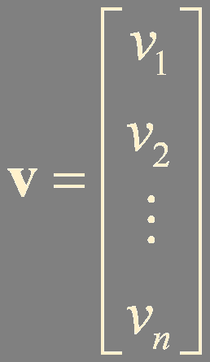

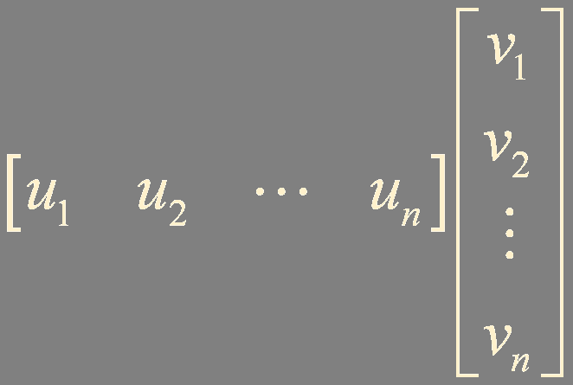


Inner Product

Slide 4
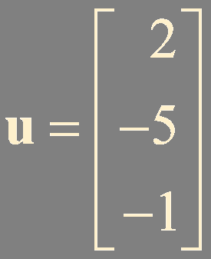
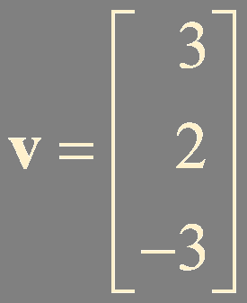
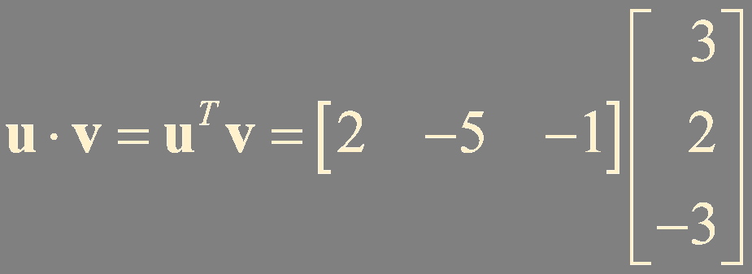

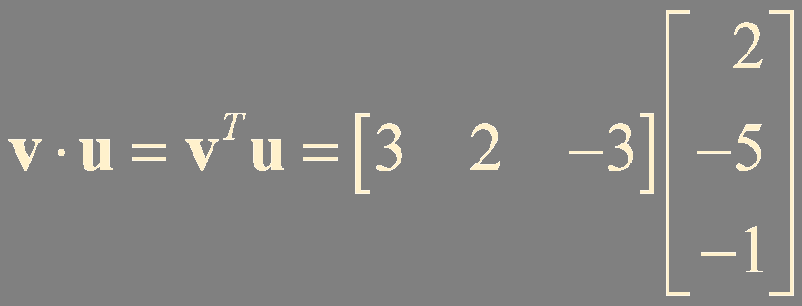

Example 1.

Slide 5
Theorem 1.
Let u, v, and w be vectors in ℝ^{n}, and let c be a scalar. Then
a. u⋅v = v⋅u
b. (u + v)⋅w = u⋅w + v⋅w
c. (cu)⋅v = c(u⋅v)
d. u⋅u ≥ 0, and u⋅u = 0 if and only if u = 0

Slide 6
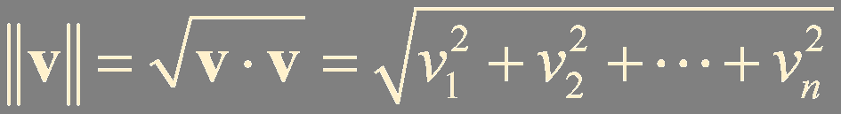

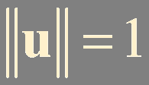
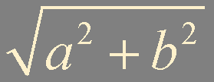
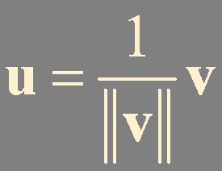
Length of a Vector
The length (or norm) of v in ℝ^{n} is the nonnegative scalar ||v|| defined by
(a, b)
unit vector
normalizing

Slide 7
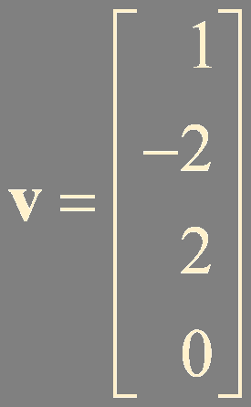
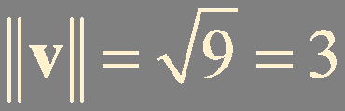
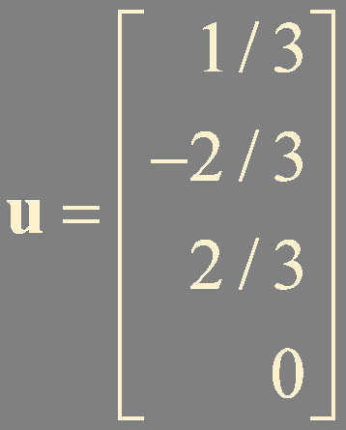
Example 2. Find a unit vector u in the same direction as v

Slide 8

Distance in ℝ^{n}
For u and v in ℝ^{n}, the distance between u and v, written as dist(u, v), is the length of the vector u-v. That is,
v
u
||u-v||
-v
u
u-v

Slide 9
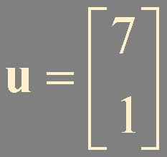
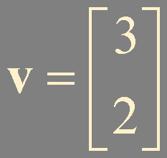
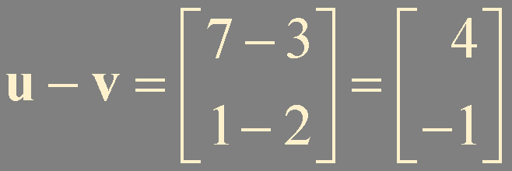

Example 2.

Slide 10



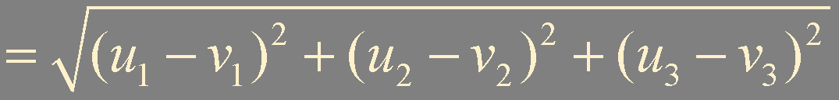
Example 3.

Slide 11



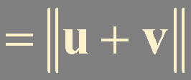
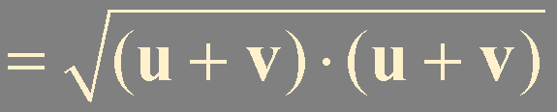

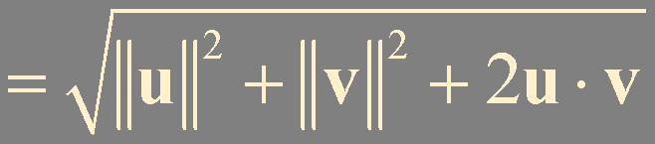
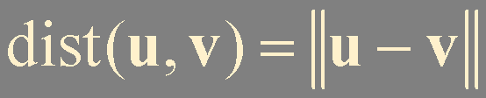
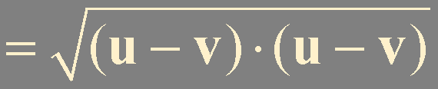

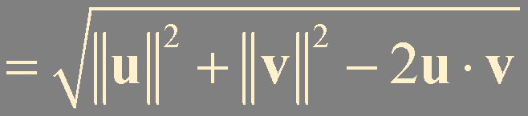


Orthogonal Vectors
Two vectors u and v in ℝ^{n} are orthogonal if u⋅v = 0

Slide 12
||u-v||
u
v
0
||u+v||
-v
The zero vector is orthogonal to every vector in ℝ^{n}
0^{T}v = 0

Slide 13
Theorem 2. Pythagorean Theorem
Two vectors u and v are orthogonal if and only if
||u + v||² = ||u||² + ||v||²

Slide 14
Orthogonal Complements
w
Let W be a plane through the origin in ℝ³
L
Let L be the line through the origin and perpendicular to W
0
z
z⋅w = 0
W
If a vector z is orthogonal to every vector in a subspace W of ℝ^{n},
L = W⊥
then, z is said to be orthogonal to W
W = L⊥
The set of all vectors z that are orthogonal to W is called the orthogonal complement of W and denoted by W⊥

Slide 15

Example 4.
?
!
Suppose a vector y is orthogonal to vectors u and v. Show that y is orthogonal to the vector u + v.
y⋅u = 0
y⋅v = 0
y⋅(v + u) = y⋅v + y⋅u = 0

Slide 16
Example 5.
?
!
Suppose a vector y is orthogonal to vectors u and v. Show that y is orthogonal to every w in Span {u, v}
w = c₁u+c₂v
w⋅y = (c₁u+c₂v)⋅y
= c₁u⋅y+c₂v⋅y
= 0

Slide 17
Example 6.
?
!
Let W = Span {v₁, … , v_{p}}. Show that if x is orthogonal to each v_{j} , then x is orthogonal to every vector in W.
x⋅v_{j} = 0, for 1≤ j ≤ p
w = c₁v₁ + ⋯ + c_{p}v_{p}
w⋅x = c₁v₁⋅x + ⋯ + c_{p}v_{p}⋅x
= 0

Slide 18
Example 7.
?
!
Let W be a subspace of ℝ^{n}, and let W⊥ be the set of all vectors orthogonal to W. Show that W⊥ is a subspace of ℝ^{n}.
u in W
z in W⊥
cz ?
in W⊥
subspace?
0
u⋅cz = cu⋅z = 0
vector sum
scalar multiplication
z₁ + z₂ ?
z₁ and z₂ in W⊥
in W⊥
u⋅(z₁ + z₂) = u⋅z₁+u⋅z₂ = 0
0 in W⊥

Slide 19

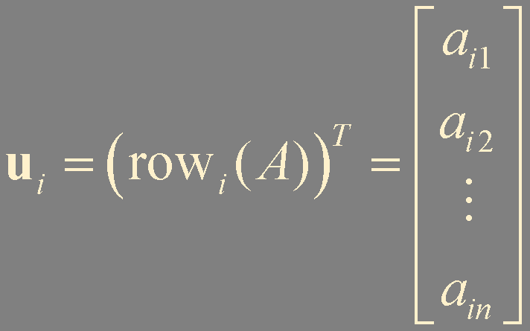
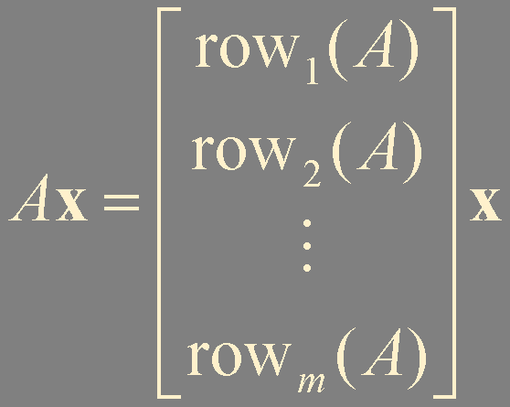
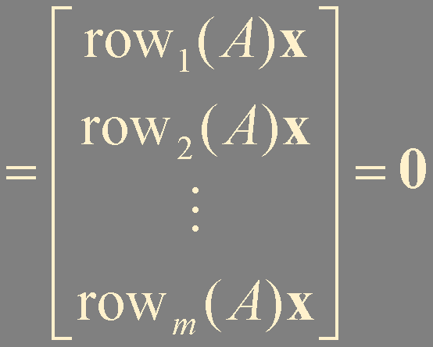
Theorem 3.
Let A be an m × n matrix. The orthogonal complement of the row space of A is the null space of A, and the orthogonal complement of the column space of A is the null space of A^{T}:
(Row A)⊥ = Nul A
and
(Col A)⊥ = Nul A^{T}
Ax = 0
x in ℝ^{n}
i-th column of A^{T}
u_{i} ⋅ x = u_{i}^{T} x = 0 , for 1≤ i ≤ m

Slide 20
Summary
Inner product
Orthogonality: orthogonal / orthogonal complement

